Slide 1
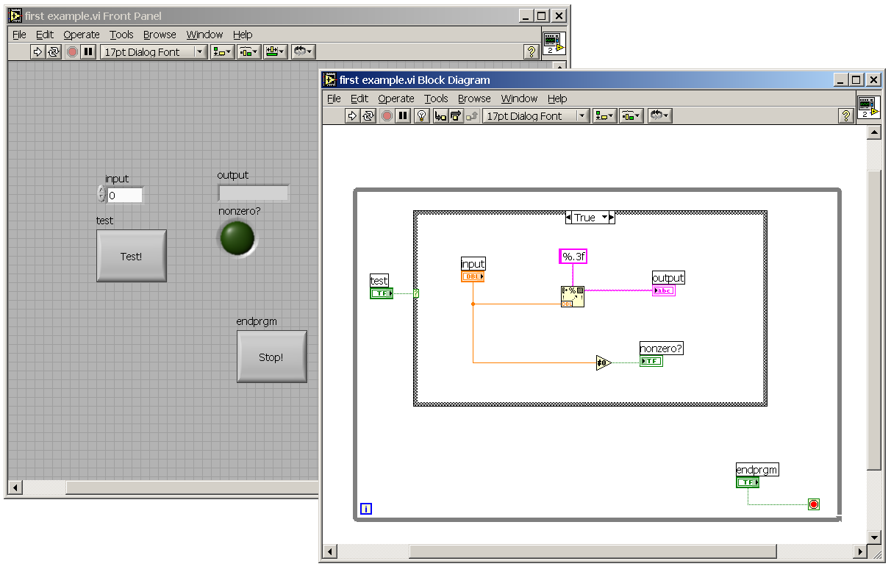
Numerical control
Function node
Wires
Case structure

Slide 2
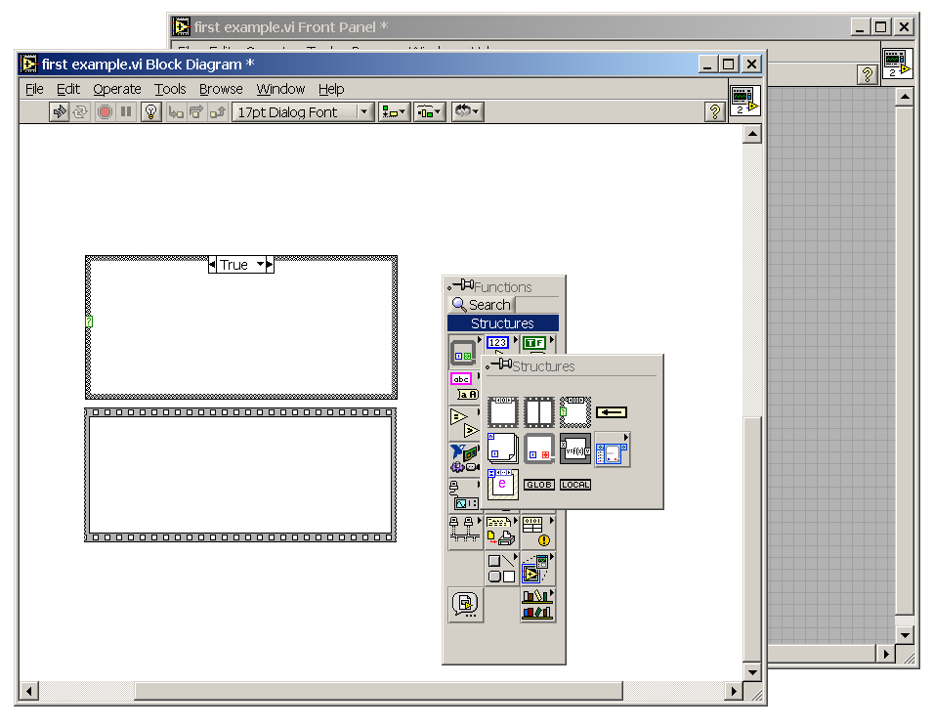
Case Selector
Structure Button
Case Structure
Palette
Case Toggle
Sequence Structure

Slide 3
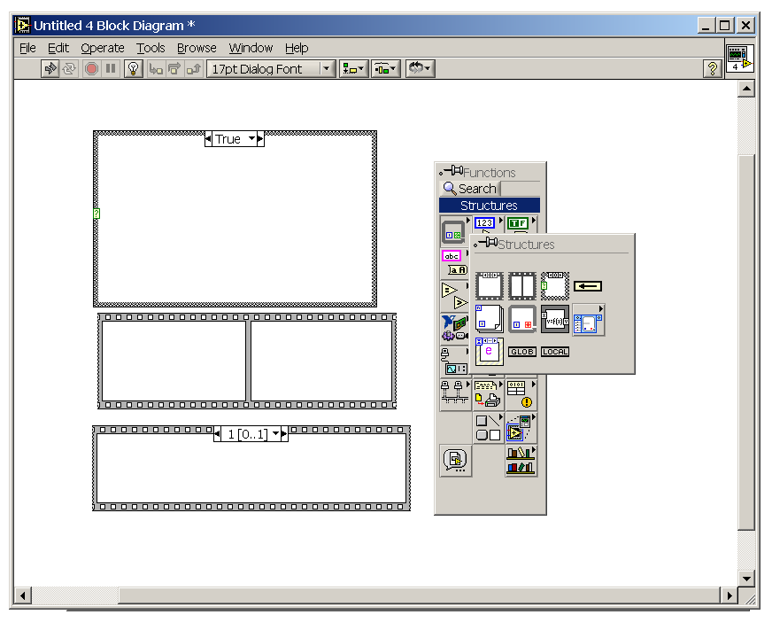
Case Selector
Case Structure
Structure Button
Case Toggle
Structure Palette
Flat Sequence
Stacked Sequence

Slide 4
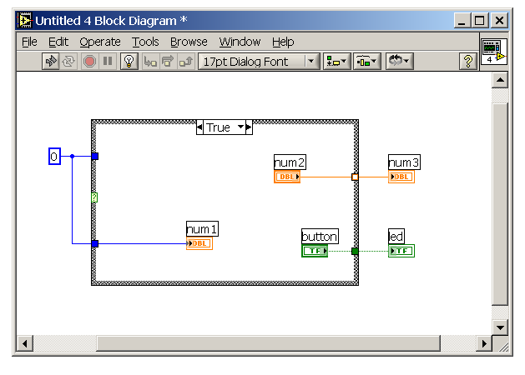
Outputs Data
Incomplete Output Node
Input Nodes
Accepts Data
Complete Output Node

Slide 5
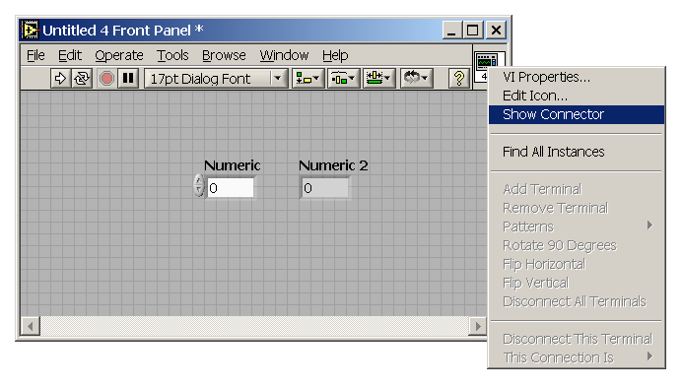
Right-Click Here

Slide 6
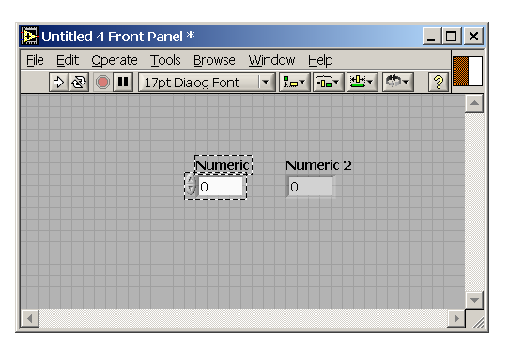
Linked Now

Slide 7
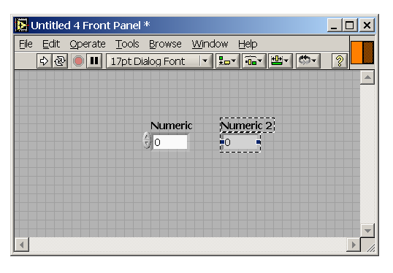
Outline Indicates it is an Output
Linked Now

Slide 8
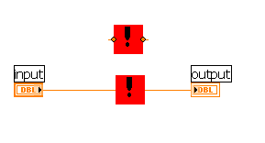
Terminals
Linked to variables
Icon

Slide 9
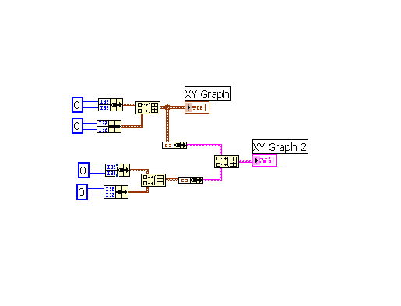
Cluster Function
Single Plot
Multi-Plot
Build Array

Slide 10
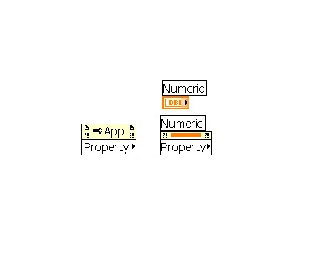
Un-linked Property Node
Linked
Linked Property
Node

Slide 11
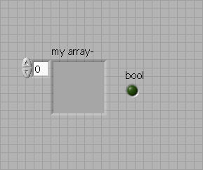
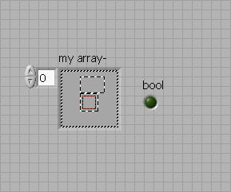
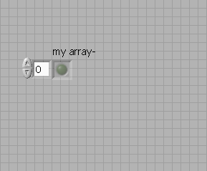
a) Empty Array
b) Putting a Boolean in the array
c) Boolean array

Slide 12
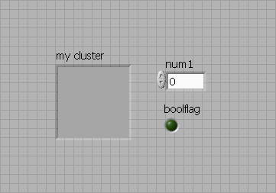
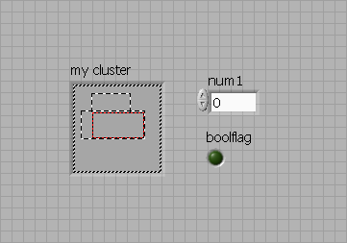
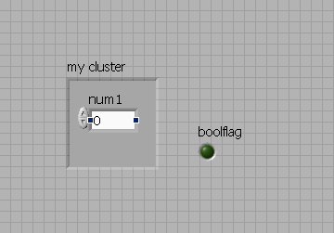
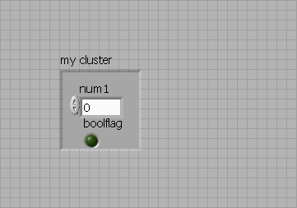
a) Empty cluster
b) Putting an object in the cluster
c) Cluster with a numeric
d) Cluster with a numeric and Boolean

Slide 13
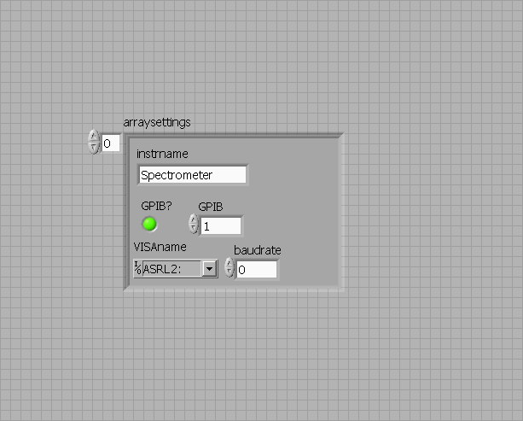
Identification (string)
GPIB setting
RS-232 settings
GPIB or RS-232 toggle

